Slide 1
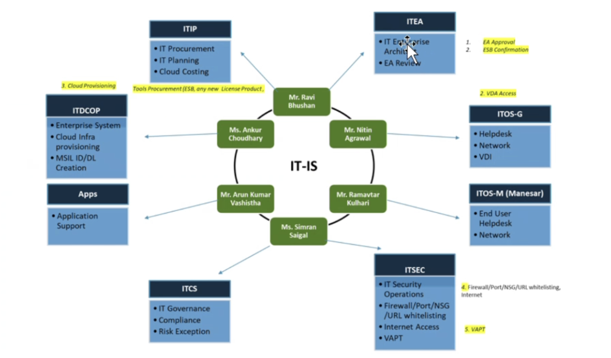
Jaipal San will share the ITEA document

